Slide 1

Introduction to Python Programming
Tuple
Ms. Shital H. Dinde

Slide 2
Tuple
Tuples are ordered collection of data items.
They store multiple items in a single variable.
Tuple items are separated by commas and enclosed within round brackets ().
Tuples are unchangeable/Immutable meaning we can not alter them after creation.

Slide 3
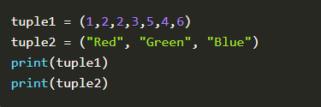


Slide 4
Tuple Indexes
Each item/element in a tuple has its own unique index.
This index can be used to access any particular item from the tuple.
The first item has index [0], second item has index [1], third item has index [2] and so on.
Negative indexing is also used to access items, but from the end of the tuple. The last item has index [-1], second last item has index [-2], third last item has index [-3] and so on.

Slide 5
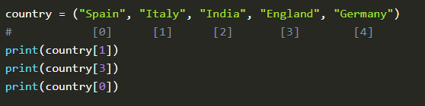
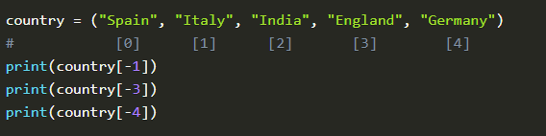

Slide 6

Range of Index

Slide 7
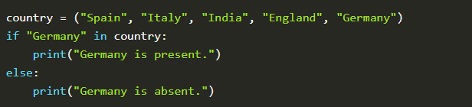
Check for item

Slide 8
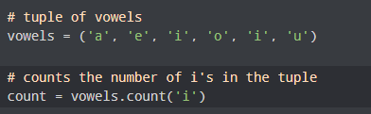

Tuple Methods
count(): The count() method returns the number of times the specified element appears in the tuple.
index(): The index() method returns the index of the specified element in the tuple.

Slide 9
Introduction to Python Programming
Dictionary
Ms. Shital H. Dinde

Slide 10

Dictionary
Dictionaries are ordered collection of data items.
They store multiple items in a single variable.
Dictionaries items are key-value pairs that are separated by commas and enclosed within curly brackets {}.
Dictionary keys must be immutable, such as tuples, strings, integers, etc. We cannot use mutable (changeable) objects such as lists as keys.

Slide 11

Accessing Dictionary items
Values in a dictionary can be accessed using keys
access dictionary values by mentioning keys either in square brackets or by using get method.

Slide 12

Accessing Dictionary items
print all the values in the dictionary using values() method.
print all the keys in the dictionary using keys() method.
print all the key-value pairs in the dictionary using items() method.

Slide 13
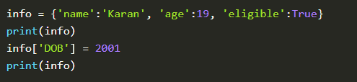

Add/Remove Items
Adding items to dictionary
Create a new key and assign a value to it
Use the update() method

Slide 14
Add/Remove Items
Removing items to dictionary
clear(): The clear() method removes all the items from the list.
pop(): The pop() method removes the key-value pair whose key is passed as a parameter.
popitem(): The popitem() method removes the last key-value pair from the dictionary.
use the del keyword to remove a dictionary item.

Slide 15






Slide 16
Introduction to Python Programming
Set
Ms. Shital H. Dinde

Slide 17


Set
Sets are unordered collection of data items.
They store multiple items in a single variable.
Sets items are separated by commas and enclosed within curly brackets {}.
Set occur in random order and hence they cannot be accessed using index numbers
Sets do not contain duplicate items.

Slide 18

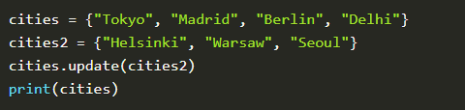
Add items to set
add a single item to the set use the add() method.
If you want to add more than one item, simply create another set or any other iterable object(list, tuple, dictionary), and use the update() method to add it into the existing set.

Slide 19


Remove items from set
remove() and discard() methods to remove items form list.
The main difference between remove and discard is that, if we try to delete an item which is not present in set, then remove() raises an error, whereas discard() does not raise any error.

Slide 20
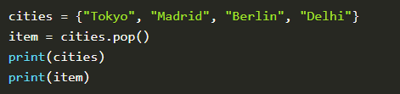
Remove items from set
pop(): removes the last item of the set but the catch is that we don’t know which item gets popped as sets are unordered. However, you can access the popped item if you assign the pop() method to a variable.

Slide 21
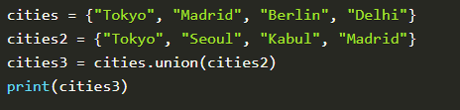

Set Methods
union() and update() : The union() and update() methods prints all items that are present in the two sets.
The union() method returns a new set whereas update() method adds item into the existing set from another set.

Slide 22
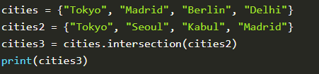

Set Methods
intersection and intersection_update(): The intersection() and intersection_update() methods prints only items that are similar to both the sets.
The intersection() method returns a new set whereas intersection_update() method updates into the existing set from another set.

Slide 23
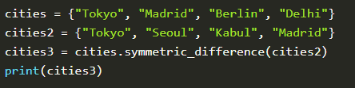
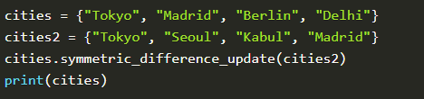
Set Methods
symmetric_difference and symmetric_difference_update(): The symmetric_difference() and symmetric_difference_update() methods prints only items that are not similar to both the sets.
The symmetric_difference() method returns a new set whereas symmetric_difference_update() method updates into the existing set from another set.

Slide 24
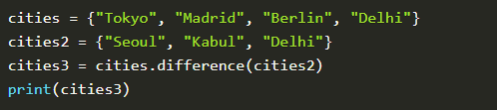
Set Methods
difference() and difference_update(): The difference() and difference_update() methods prints only items that are only present in the original set and not in both the sets.
The difference() method returns a new set whereas difference_update() method updates into the existing set from another set.

Slide 25

Set Methods
isdisjoint(): The isdisjoint() method checks if items of given set are present in another set. This method returns False if items are present, else it returns True.

Slide 26
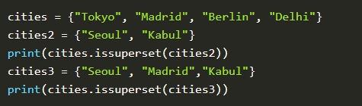
Set Methods
issuperset(): The issuperset() method checks if all the items of a particular set are present in the original set. It returns True if all the items are present, else it returns False.

Slide 27

Set Methods
issubset(): The issubset() method checks if all the items of the original set are present in the particular set. It returns True if all the items are present, else it returns False.

Slide 28
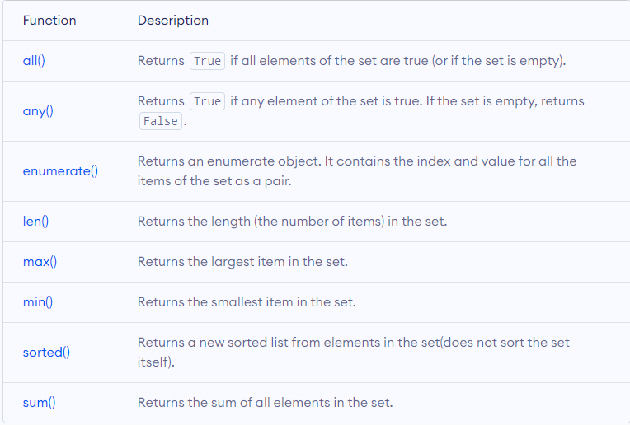

Slide 29


Questions?

Slide 30

8888 763 563
88 5335 4141
https://svlautomations.in
https://svltrainings.in

